Slide 1

Intuit CRAFT DEMO
BY GOUTAM BOSE

Slide 2
AGENDA OF THE DAY
Introduction
Requirement Detailing
Assumptions made for the solution
Usage discussion
API
Entities
Class Diagram
Algorithm used
Demo and Code Walkthrough
Drawbacks/Further Enhancements for better scaling

Slide 3
INTRODUCTION
3 years of total experience in Java, C/C++, Networking & Healthcare Domain
Currently working as Developer 2 @ Hyland Software
Working on a product called OneContent that helps the hospital chains to manage the
Patient medical records efficiently and takes care of all the workflows of the patients.
Tech Stack currently in use : Java 8, Spring MVC, Hibernate, SQL server
Previous experience :
Software Engineer 1 @ F5 Networks
R & D Engineer 1 @ Keysight Technologies
Technical Interests : Data Structures & Algorithms

Slide 4

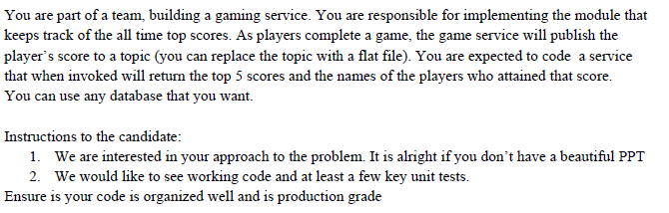
REQUIREMENT

Slide 5
Assumptions
The score published by gaming service is always for a registered user/proper guest user and valid score. We don't need to validate the score or player which is published by gaming service.
When two players have the same score, the player ranking is done reverse lexicographically according to username, player usernames are unique.
For each player data there won't be any simultaneous update - one player plays from one device at a time.
Scores will be single numerical value and for the leaderboard there will be a fixed number N decided while application start according to which the top N scores will be returned with player usernames.
All the APIs exposed are used by the gaming service internally and no API is exposed publicly so we are assuming here that the APIs need no data sanity check and will be used mostly as-expected sequentially. Also, this eliminates the need of authentication & authorization.
There is only one leaderboard for the time being however if needed the number of leaderboards can be extended.
The traffic involved in the services for now is within the range of a single server range - but will be scaled as per need

Slide 6
FLOW/USAGE
Admins can create and register a leaderboard - while creation if there is already internal data present in datastore they are also processed
As soon as leaderboard is registered, it becomes ready to ingest score and can ingest the scores
The score ingestion service ingests the score for a player to leaderboard as well as stores the score into a persistent storage.
As and when score is ingested after a game is finished, the leaderboard is updated
At any point of time, after leaderboard registration, the top N player score details can be fetched.

Slide 7
API/ENDpoints exposed
/createBoard - Admins can create and register a leaderboard - while creation if there is already internal data present in datastore they are also processed.
Takes the leaderboard id and leaderboard size as input
Returns 200 OK on success and 500 for failure.
/getTopScorers – Retrieves a JSON array of the top N players. N is fixed by /createBoard.
Returns 200 OK on success and a JSON array of top N players.
If leaderboard is not initialized, returns 400 Bad Request otherwise 500 for other failures.
/updateScore - Posts a new score for a player into the queue.
Takes the player username and score as input
Returns 200 OK on success and 500 otherwise.

Slide 8
Entity
@Entity
@Table(name="PLAYERSCORE")
playerScore {
@Id
@Column(name="player_id")
String playerId; //Username of the player
Long score; //Score after each game
public int compareTo(playerScore p) {
if (this.score == p.getScore()) {
return this.playerId.compareTo(p.getPlayerId());
}
return Long.compare(this.score, p.getScore());
}
}
public class inputForLeaderBoard {
String boardID;
Integer leaderBoardSize;
}

Slide 9
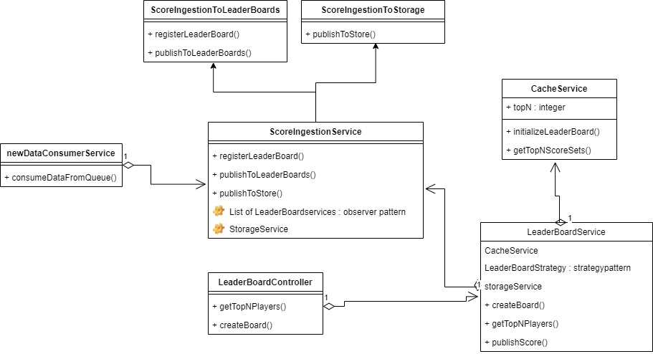
Class diagram

Slide 10
ALGORITHM used for CACHESERVICE
We are using a combination of Min Heap and HashMap.
To maintain the top K score we are using Min Heap
While updating the leaderboard, we check and compare if the score for the player that is being updated is already present in the Min Heap or not. If the player is already on the leaderboard and the new score is greater than the present score, we update the rank else we ignore.
Time Complexity : O(NlogK) to create the Heap. N being the total number of scores processed and K being the size of leaderboard. For updating leader board, O(logK) and for retrieving, it is O(K).
Space Complexity : O(K)

Slide 11
DEMO AND CODE WALKTHROUGH

Slide 12
DRAWBACKS/FURTHER ENHANCEMENTS
Ideally, for a system like leaderboard(category of the Heavy Hitter problem) where there will be massive scale of traffic to be processed, there have been many ways suggested – most popular of which is to ingest the data into Apache Spark pipeline with Map Reduce and process the top K scores in real time and store in a Sorted Set with Redis Cluster. Redis Cluster being an in-memory datastore will be much more scalable compared to how we are using Min Heap here. Moreover, it’s distributed nature will be much more resilient and fault tolerant.
SCOPE OF EXTENSIBILITY : The Cache Service has been intentionally separated from the leaderboard service to create scope of changing the Min Heap to Redis or similar Cache as and when needed.
Each of the services should be containerized and the monolith can be broken down to microservices.
Right now, we are just retrieving the top K scores based on numerical comparison however this might become complicated as and when complexity of the game increases and there can be many more factors involved to decide the leaderboard, we can extend the leaderboard strategy using strategy pattern to pass on the correct strategy for comparison to cache service.

Slide 13

QUESTIONS

Slide 14
REFERENCES
https://helloacm.com/design-a-leaderboard-using-priority-queue-hash-map-unordered_map-or-hash-set-multi_set/
https://aws.amazon.com/blogs/database/building-a-real-time-gaming-leaderboard-with-amazon-elasticache-for-redis/
https://redis.com/solutions/use-cases/leaderboards/
GITHUB REPO
https://github.com/Goutam1511/Intuit-Craft-Demo-LeaderBoard

Slide 15

THANKS

